Slide 1
MIS 6356 Business Analytics with R Project Report - Expedia Dataset

Slide 2
Getting value from data is difficult but…
“If you torture the data long enough, it will confess.”
-Ronald Coase, Economist

Slide 3
Why we chose Expedia?
Huge volumes of data generated online
Use of analytics for customer behavior prediction
Scope of improvement
Directly adding value to Expedia business
Challenges in handling more than 10 million records

Slide 4
Data Description
In this project, we are using Expedia’s dataset that includes shopping and purchase of customer data as well as information on price competitiveness.
The data are organized around a set of “search result impressions”, or the ordered list of hotels that the user sees after they search for a hotel on the website along with other details like promotions, user review etc. for the hotels.
The user response is provided as a click on a hotel or/and a purchase of a hotel room. Using this Expedia dataset we are predicting if the final booking has been done by the user.

Slide 5
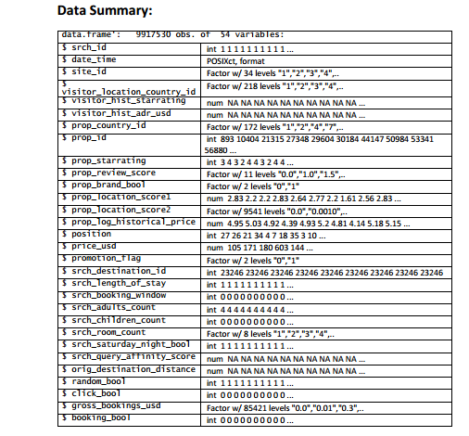

Slide 6
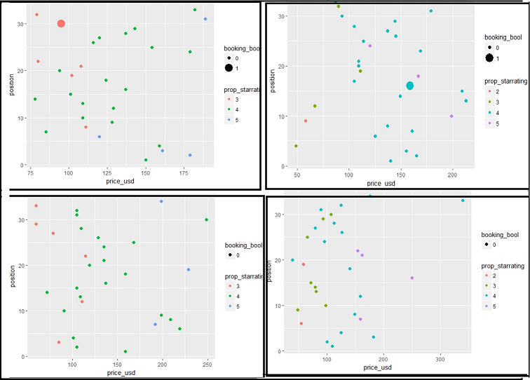
Various Insights
Number of hotels booked by customers based on the property star rating, position and price_usd.

Slide 7
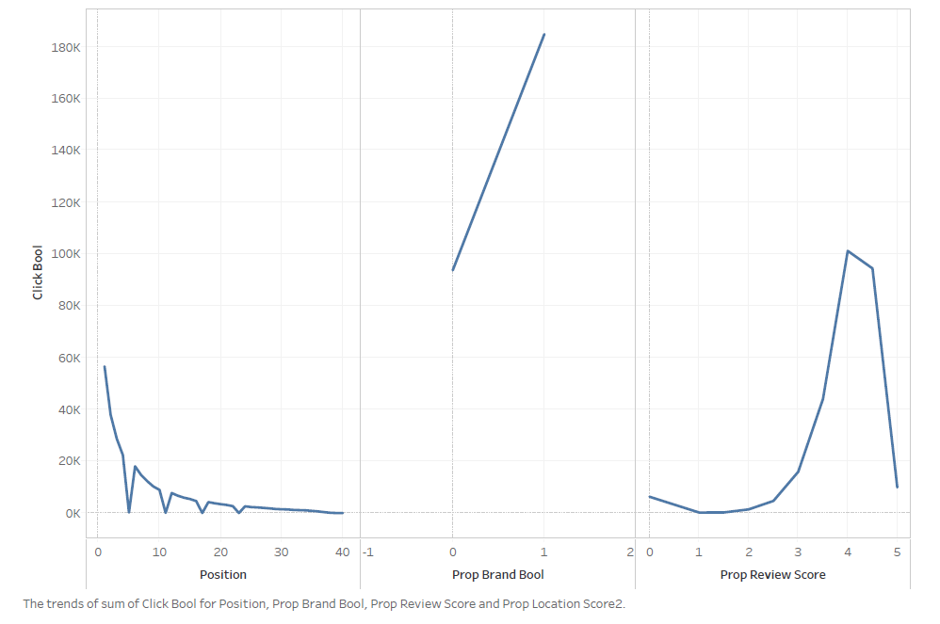
Continued…
This shows that the review score slightly above 4 has a negative impact on the y variable.

Slide 8
Exploratory Data Analysis (EDA) Why EDA?
Detection of mistakes
Checking of assumptions (feature engineering)
Preliminary selection of appropriate models
Determining relationships among the explanatory variables (Correlation)
Assessing the direction and rough size of relationships between explanatory and outcome variables.

Slide 9
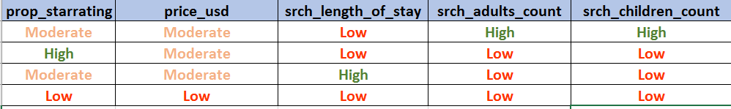
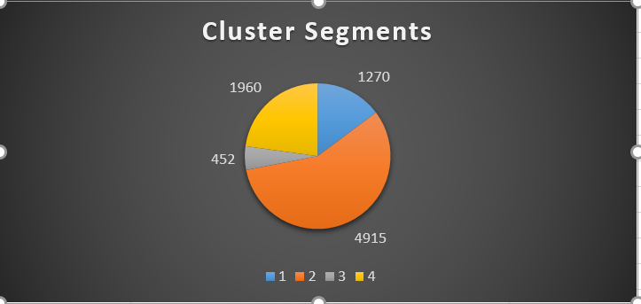
EDA: 1) Clustering
Based on these segregation, we have named four clusters as follows:
Cluster | Description |  | %
1 | Average Rating_ShortStay_big Family | 1270 | 14.77%
2 | High Rating_ShortStay_Small Family | 4915 | 57.17%
3 | Average Rating_LongStay_Small Family | 452 | 5.26%
4 | Low Rating_LowCost_Short Stay | 1960 | 22.80%

Slide 10
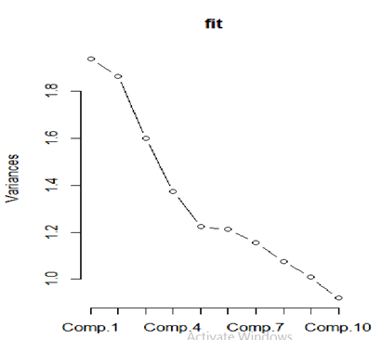
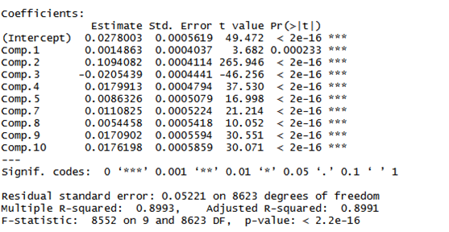
EDA: 2) Dimensionality Reduction
This gives 9 Principal components out of 19 components
It has a R2 and Adjusted R2 of approximately 90%

Slide 11
Data Preprocessing
Data Partitioning
Eliminated data biasing keeping equal set of 0’s and 1’s in the response variable.
Removed multicollinearity between the predictor variables using correlation analysis.
Eliminated the columns with more than 98% missing values.
Data Imputation using MICE package
Feature Scaling - normalization

Slide 12
Business Intelligence Models:
1. Linear Model
2. Decision Trees
3. Random Forest
4. Logistic Regression
5. Support Vector Machines
6. k -Nearest Neighbor

Slide 13
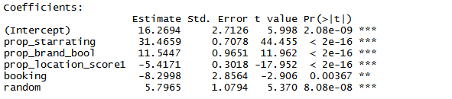

1. Linear Model
Here we are predicting the response variable price_usd using the significant predictors using the co efficient of determination or R-square and Adjusted R-square values.
This response variable provides the booking price of the hotel is USD.

Slide 14
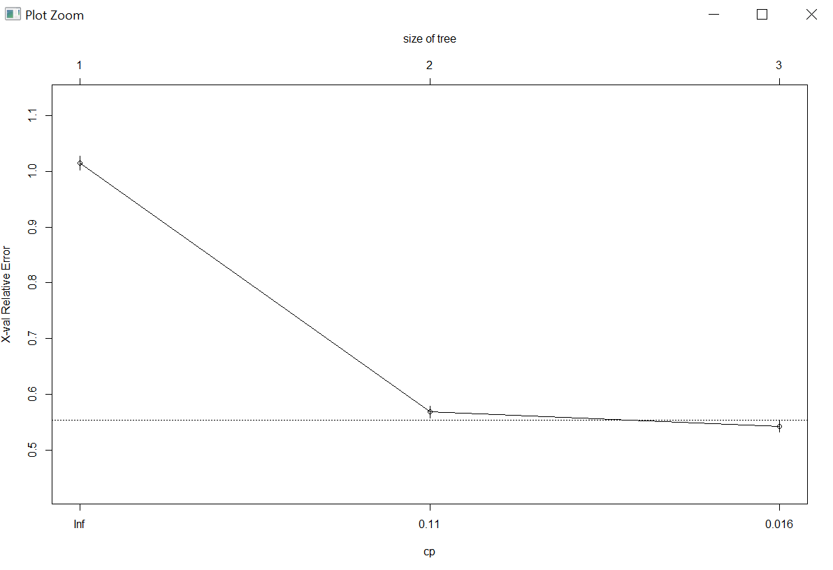
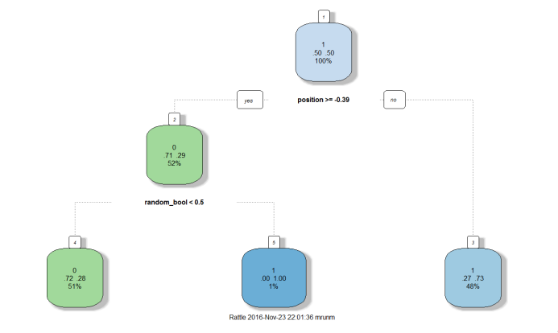
2. Decision Tree
Actual/Predict | 0 | 1
0 | 8551 | 2890
1 | 3501 | 8058
Accuracy Rate = 0.7221 | Error Rate = 0.277

Slide 15
3. Random Forest
We ran our random forest with 10, 100 and 500 number of trees
# of trees =10 | 0 | 1
0 | 41021 | 14227
1 | 15527 | 39743
Accuracy Rate = 0.73 | Error Rate = 0.269
# of trees =100 | 0 | 1
0 | 40482 | 14766
1 | 14950 | 40320
Accuracy Rate = 0.731 | Error Rate = 0.268
# of trees =500 | 0 | 1
0 | 40487 | 14727
1 | 14761 | 40543
Accuracy Rate = 0.733 | Error Rate = 0.269

Slide 16
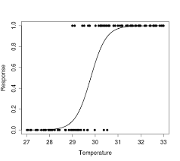
4. Logistic Regression
 | 0 | 1
0 | 36686 | 12216
1 | 18562 | 43054
Accuracy Rate= 0.721 | Error Rate = 0.278

Slide 17
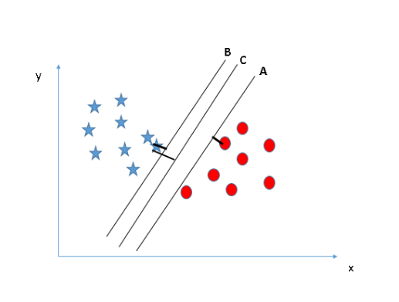
5. Support Vector Machines
 | 0 | 1
0 | 1765 | 762
1 | 634 | 1839
Accuracy rate = 0.72 | Error rate= 0.279

Slide 18
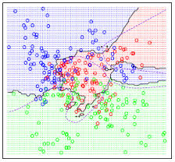
6. k -Nearest Neighbor
 | 0 | 1
0 | 1718 | 809
1 | 808 | 1665
Accuracy rate = 0.6766 | Error rate= 0.323

Slide 19
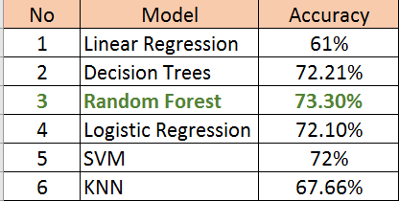
Findings and Implications
Better suggestions of hotel based on 4 key factors for prediction
Divided the population into 4 clusters which can be used for targeting customer segments for future target marketing
We chose random forest to be the best models as the best predictor from the key variables.

Slide 20
Delivering value to expedia
Hotels positioned at 1st , 2nd and 3rd have high chances being clicked on.
Considering other parameters constant, there is less chance of a hotel being picked by a customer if the hotel is positioned at places 4th , 5th and 6th .
A hotel that is recognized by a brand has 28% higher chance of getting picked by a customer.
Review scores from 3.5 to 4.5 have higher chances of getting clicked

Slide 21
Delivering value to expedia
Using classification models such as Logistic Regression, Random Forests , SVM we are able to predict the probability of a hotel being booked by a potential customer.
These insights are used in a ranking algorithm that uses the click data and customer database to deliver personalized results for a hotel search query
We can strategically position our search results to reduce bounce rate and increase the chance of converting a search into booking
Using customer properties, we have classified them into a clusters and will use them in a ranking algorithm which will rank the hotels based on the probabilities predicted by our classification models.
If customer belongs to Average Rating_ShortStay_big Family, our models are able to estimate the probability of a sale with 69% accuracy.
If customer belongs to High Rating_ShortStay_Small Family, our models are able to estimate the probability of a sale with 83% accuracy.
If customer belongs to Average Rating_LongStay_Small Family, our models are able to estimate the probability of a sale with 73% accuracy.
If customer belongs to Low Rating_LowCost_Short Stay, our models are able to estimate the probability of a sale with 49% accuracy.

Slide 22
Summary
Based on these results Expedia can predict the hotel based on user behavior and property popularity. This will guide user to choose the best possible property in the initial search list.
We used various data preprocessing techniques to cleanse the data, scale the data.
We have tried out modelling the project using 5 different statistical approaches to predict booking by users based on key variables.
From the results obtained, the Random forest model is identified as the feasible approach, as it yields the highest accuracy based on evaluating classifiers.
By having more valid competitor data by imputation through functional acumen we can increase the accuracy of the model in turn increasing the predicting ability.

Slide 23
References
[1] https://www.cs.princeton.edu/courses/archive/spring07/cos424/papers/mitchell-dectrees.pdf
[2] https://www.analyticsvidhya.com/blog/2016/04/complete-tutorial- tree-based- modeling-scratch- in-python/
[3] Lecture Notes
[4] https://www.youtube.com/
[5] https://www.r-bloggers.com/how-to-learn-r-2/
[6] http://stats.stackexchange.com/
[7] http://stackoverflow.com/

